Slide 1
WEBRTC
BY DHRUV DHOLARIYA

Slide 2
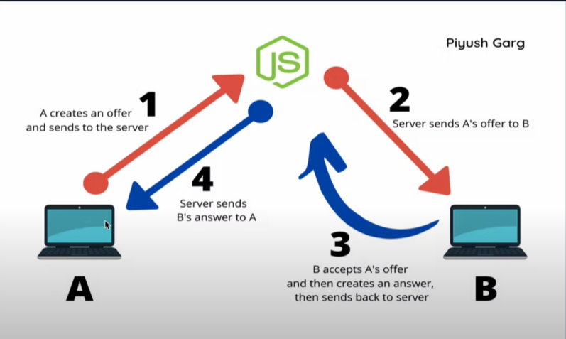

Slide 3
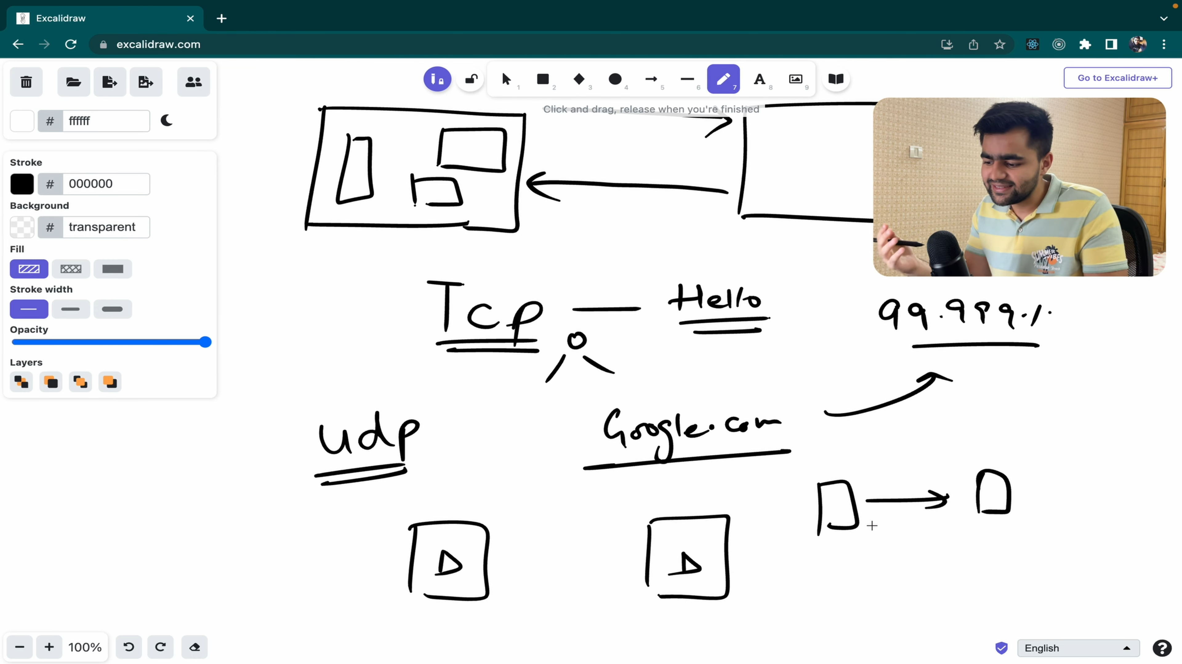

Protocoal we used in webrtc , with no server

Slide 4
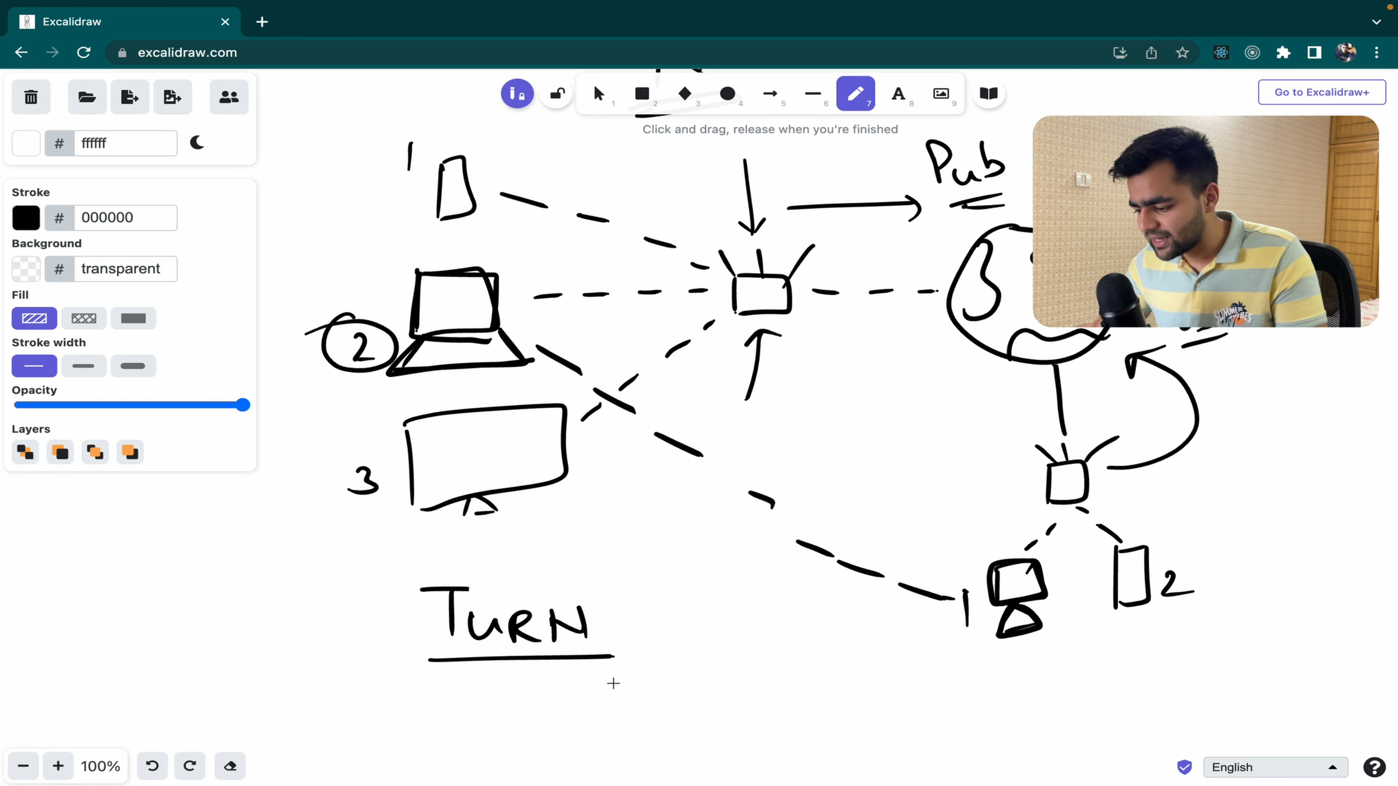




Turn server are used to connect two system

Slide 5
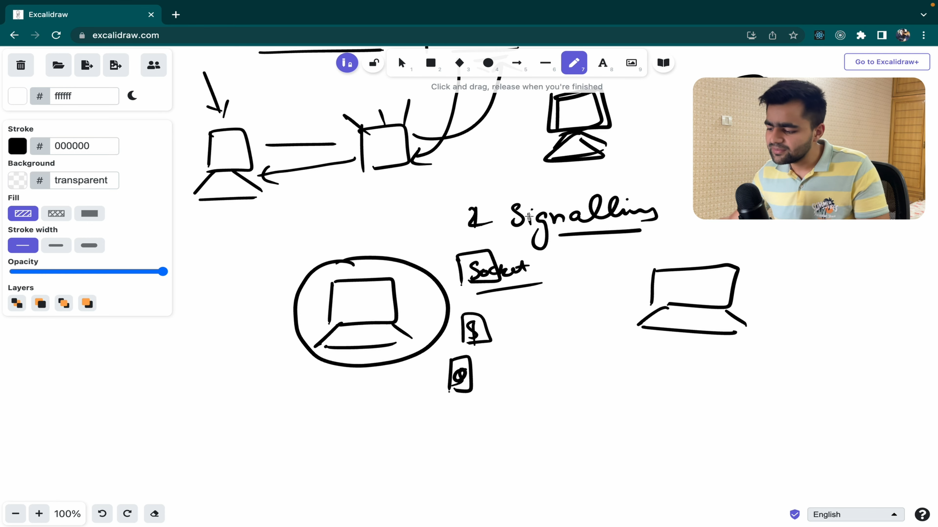
We want to share file and chats , so we create a socket server which is responsible for sharing two clients ip address with each other

Slide 6
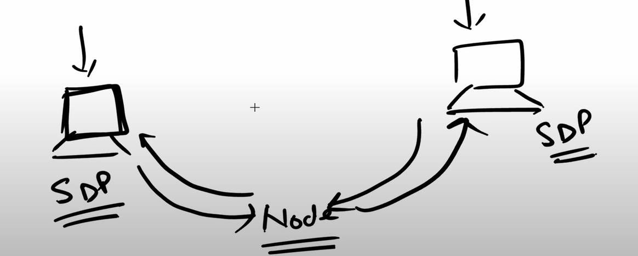
SDP stands for Session Description Protocol.
DP is used by WebRTC to negotiate the session's parameters. Since there is no signaling in WebRTC, the SDP created and used by WebRTC is assumed to be communicated by the application and not by WebRTC itself.

Slide 7
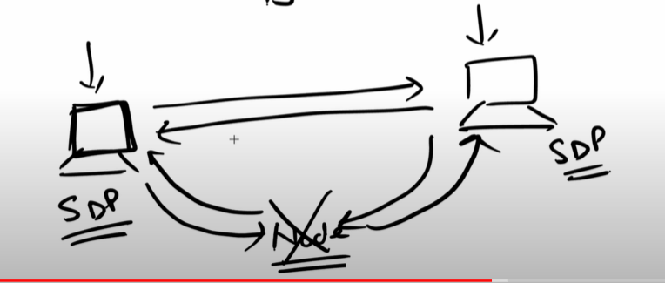








This is P2P architecture – Architecture-1

Slide 8
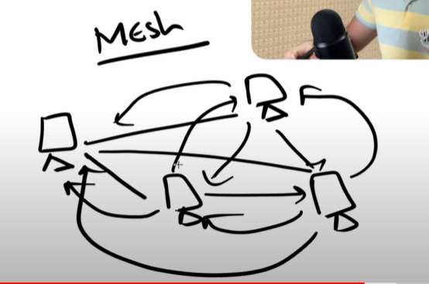
Architecture-2

Slide 9
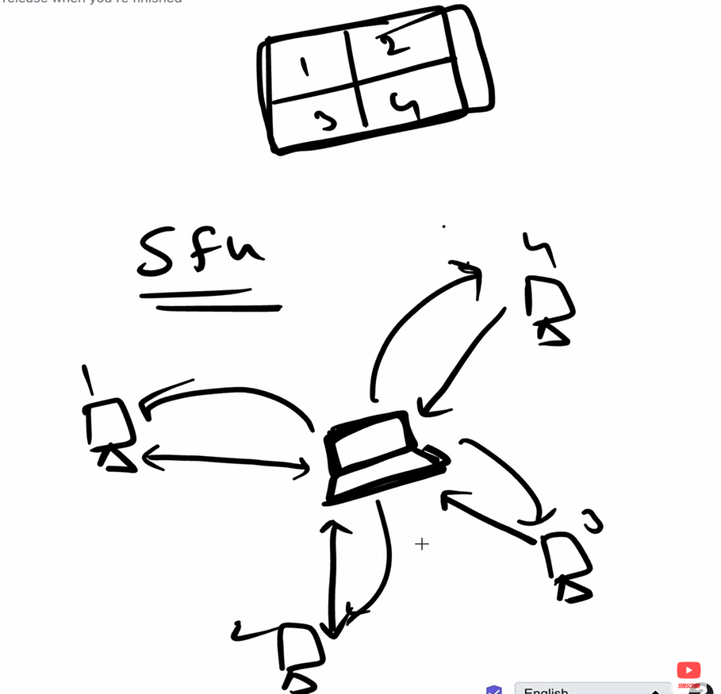
Architecture-3 - SFU
(Selective Forwarding Unit)
mostly USED IN ZOOM ,
GOOGLE MEET

